Slide 1








TO DO LIST
Team
Mit Jain (51)
Shefali Vinay Jain (53)
Shruti khanvilkar (65)

Slide 2




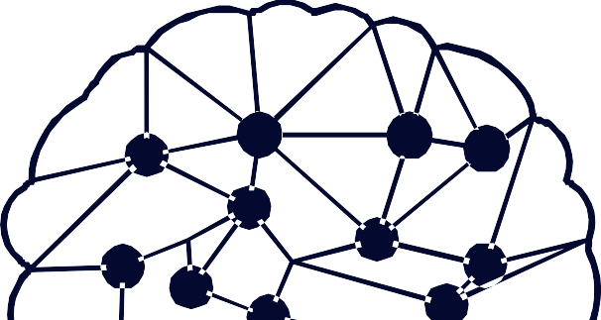


Index
01
Problem Statement
02
Introduction
03
Description
04
Implementation
05
Learning outcome

Slide 3
Problem Statement
Traditional task managers often lack seamless integration, user-friendly interfaces, and robust collaboration features, while also facing issues like limited reminders, inadequate time management tools, and accessibility constraints. These are the problem of normal task manager:
Limited Integration
Lack of Customization
Limited Collaboration Features
Difficulty in Time Management
Cost and Accessibility

Slide 4





Introduction
In today's fast-paced world, where multitasking and juggling numerous commitments are the norm, Todo app have become essential companions for enhancing productivity and efficiency.
From managing work projects and household chores to tracking academic assignments and personal goals, Todo app offer a comprehensive solution for staying organized and focused.
By providing a clear roadmap of tasks and priorities, Todo app empower users to make informed decisions about how to allocate their time and resources, ultimately leading to greater success and fulfilment in both their personal and professional lives.

Slide 5
Description
Cloud Services
AWS Elastic Beanstalk
Amazon Relational Database Service (Amazon RDS) Amazon Virtual Private Cloud (Amazon VPC) Methodologies Used
GTD and kanban
Software Requirements
Front-end Technologies: - HTML5, CSS3, and JavaScript and Python(Flask) for building the user interface
Back-end Technologies: - MySQL WorkBench
Database: - MySQL , RDS

Slide 6
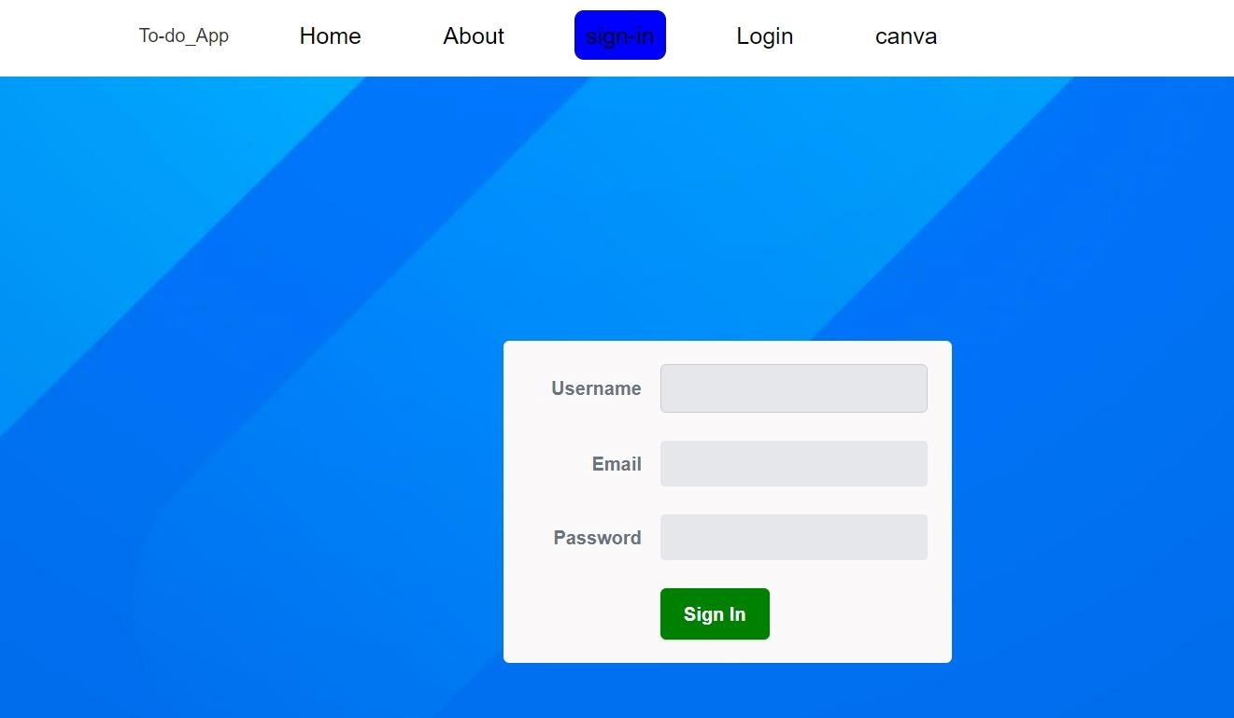
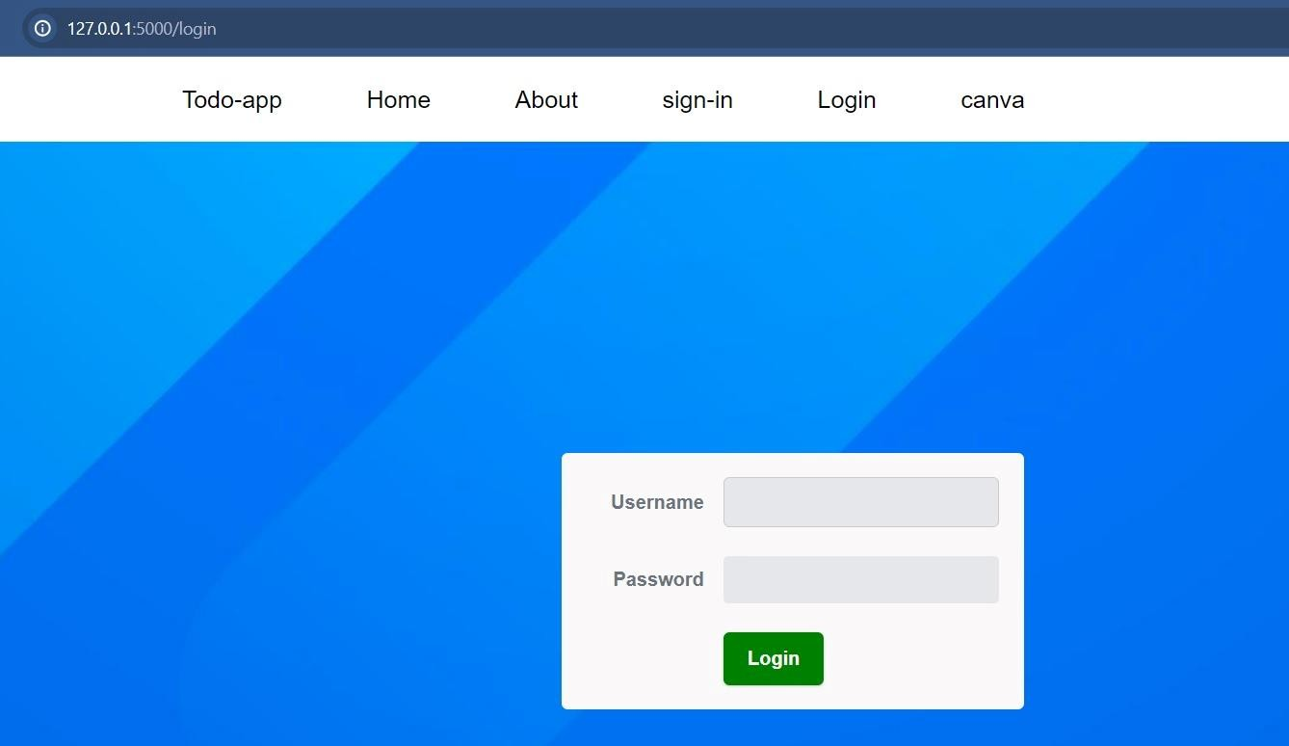
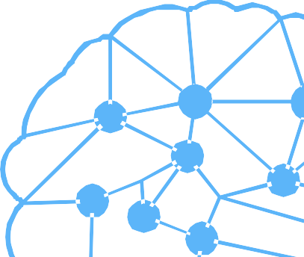
Implementation
SIGN UP PAGE
LOGIN PAGE

Slide 7
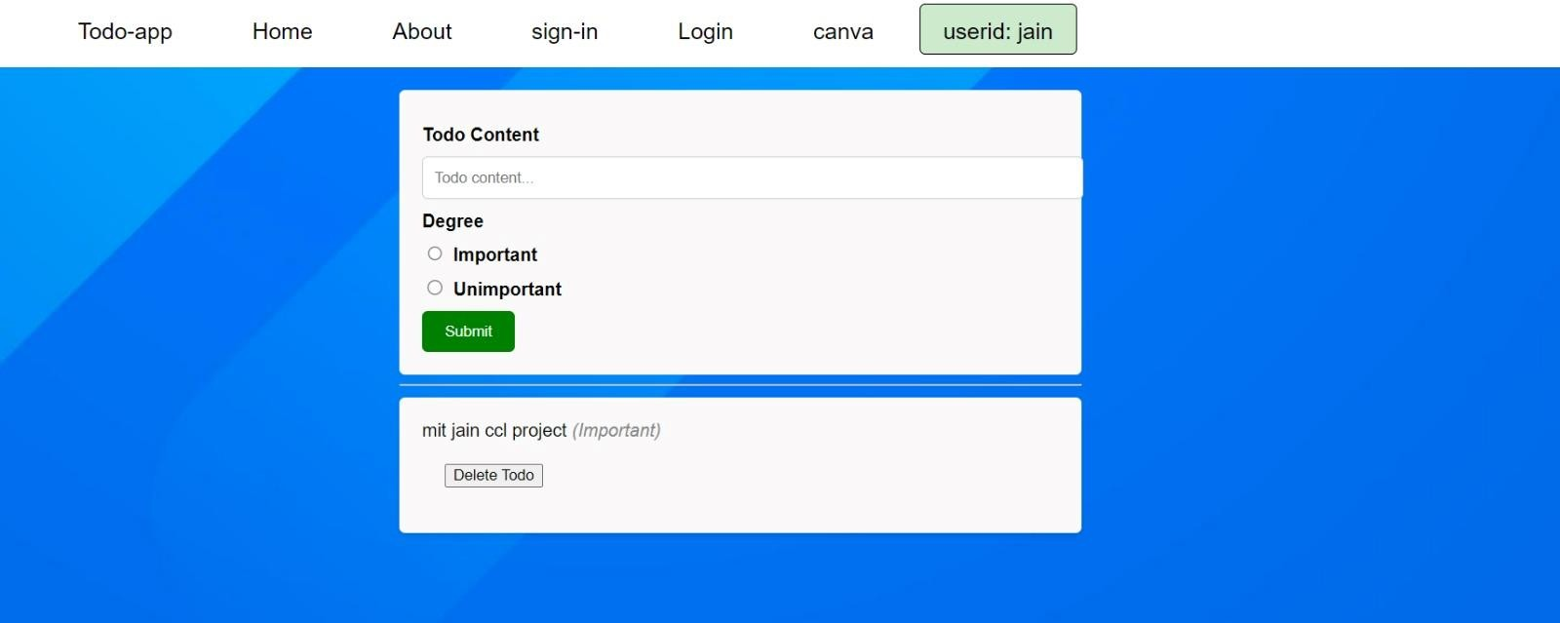
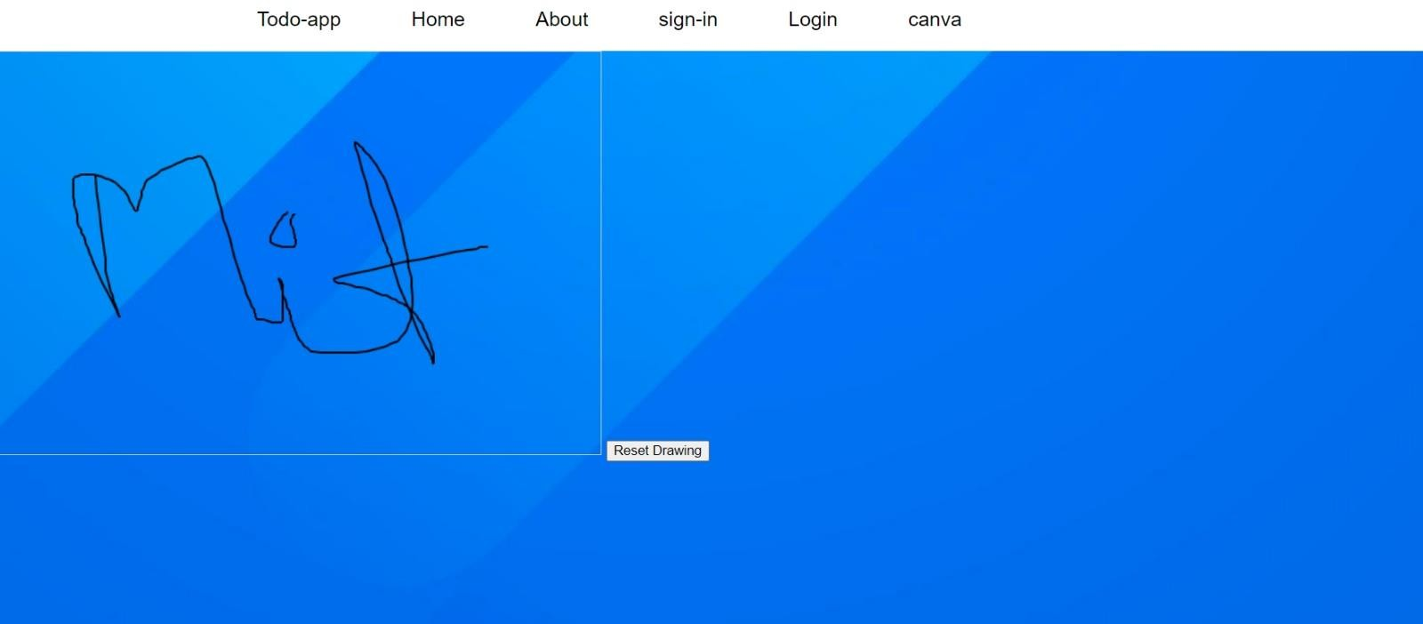
Implementation
HOME PAGE
SELECTING DRAWING

Slide 8
LEARNING OUTCOME
Stay Organized
Prioritize Tasks
Meet Deadlines
Reduce stress
Increase Productivity
Access Task Anywhere

Slide 9




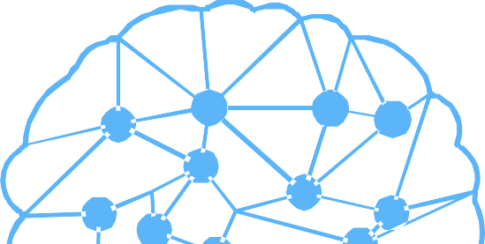

Thank You

